Slide 1
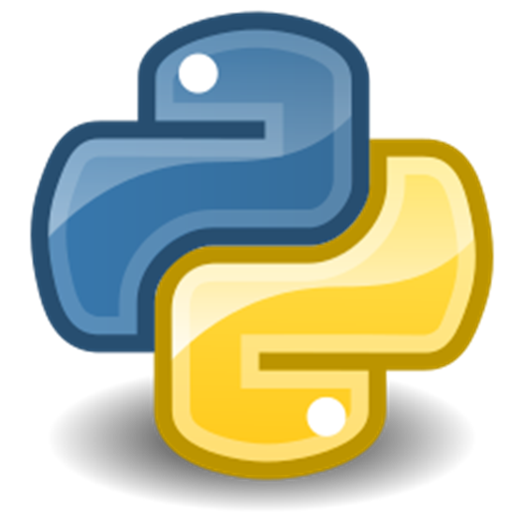

Introduction to Python
Fondren Library
Digital Scholarship Services

Slide 2


WHAT IS PYTHON?
Invented by a Dutch programmer Guido van Rossum as a “hobby” during Christmas week, 1989
Name comes from “Monty Python”
Open source
Companies: Instagram, Amazon, Facebook, SurveyMonkey…
Design philosophy: “Readability counts”
Small core language with a large standard library

Slide 3
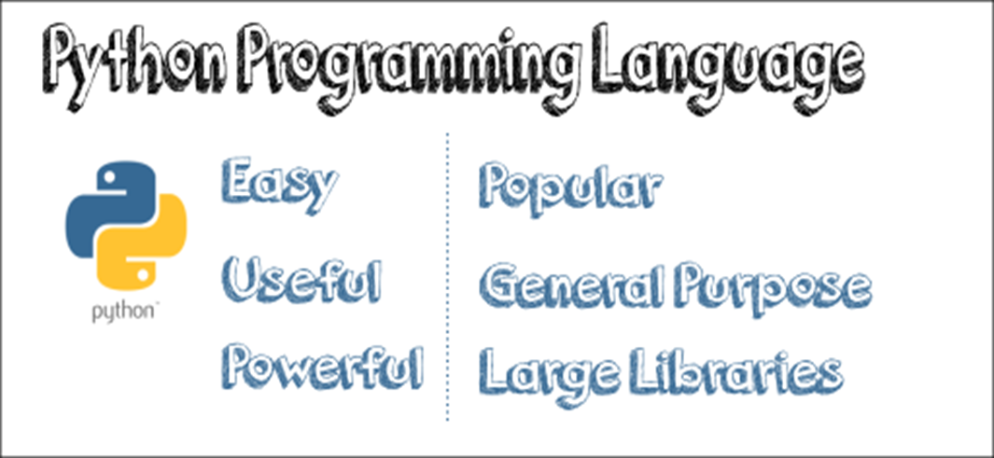
Why PYTHON?
#Python
print ("Hello world!" )
#Java
public class Main {
public static void main(String[ ] args) {
System.out.println( "Hello, World!’’ );
}
}

Slide 4
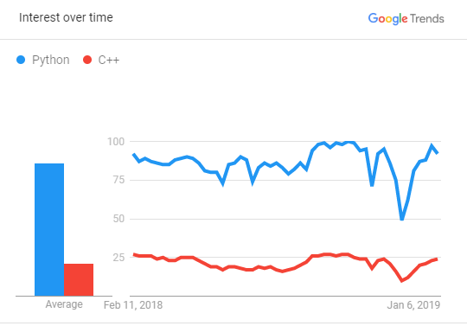
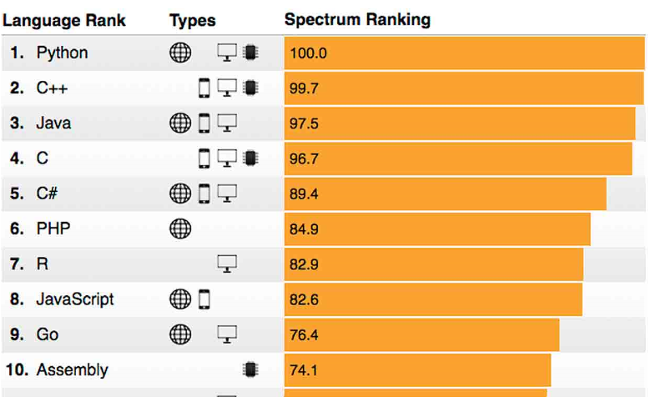
One of the most popular programing languages
Source: Google Trend
Top Ten Languages of 2018
Source: IEEE(Institute of Electrical and Electronics Engineers)
Spectrum’s fifth annual interactive ranking of the top programming languages

Slide 5
PYTHON IS USED FOR
Web Development
Data Analysis/visualization
Machine Learning
Web Scraping

Slide 6

Over 6 million users
Works on Linux, Windows, and Mac
1400+ packages pre-installed
IDEs including: Jupyter, JupyterLab, Spyder, and RStudio
Anaconda

Slide 7
DATA TYPES
Python knows various types of data. Common ones are:
Strings – “a”, “hi”
Integer numbers – 2, 4, 6,
Floating point numbers – 3.14, 2.0, 2.12
Boolean – True/False

Slide 8
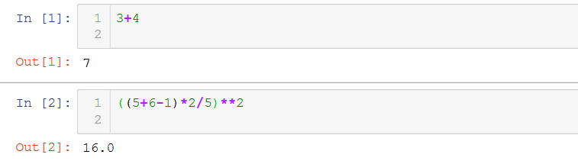
USE AS A CALCULATOR MATHEMATIC OPERATORS
+, -, /, *, %
# Exercise 1:
# Radius=5, π=3.14, calculate the area of the circle

Slide 9
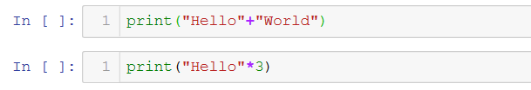
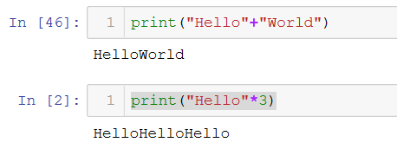
OPERATORS WORK DIFFERENTLY BASE ON DATA TYPE

Slide 10
LOGIC OPERATORS <, >, ==, !=, <=, >= AND STATEMENTS and, or, not RETURN BOOLEAN DATA TYPE

Slide 11


CHECK AND CHANGE TYPES BUILT-IN FUNCTION type

Slide 12
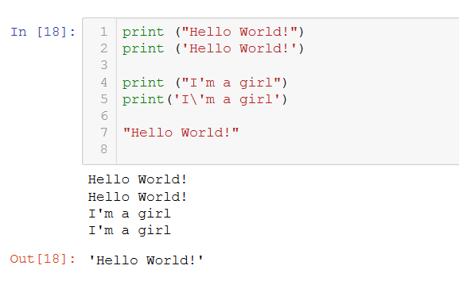
PRINT TEXT
"escape" character.

Slide 13


INPUT
#Exercise 2:
Create a variable Gender, prompts a question, "Are you a boy or a girl?"
print "You are a " + input

Slide 14
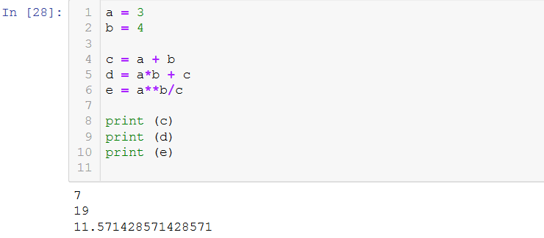
ASSIGNING VARIABLES

Slide 15
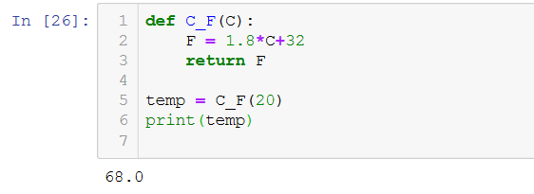
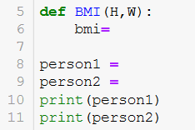
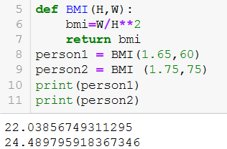
USER-DEFINED FUNCTION
Exercise 3: Create a BMI function and calculate BMI for person1 and person2. BMI = weight/height²
# person1: height:1.65m, weight:60kg
# person2: height:1.75m, weight:75kg

Slide 16
BASIC DATA STRUCTRUES IN PYTHON
Lists [1,2,3] ordered and changeable
Tuples (1,2,3) ordered and unchangeable
Dictionary {‘a’: 1, ‘b’:2, ‘c’:3} unordered, changeable and indexed

Slide 17

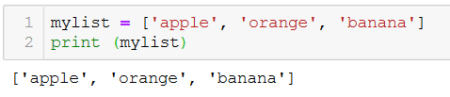
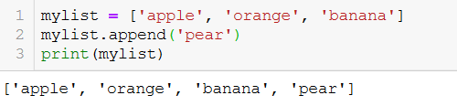

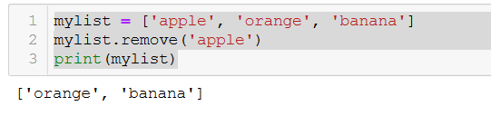
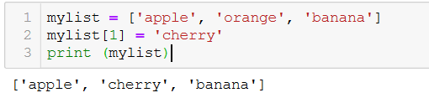
LIST
Create a list:
Access item:
Add Items:
Remove Items:
Change Item Value:
Exercise 4:
Create a list of your favorite songs, print the list
Print the 3rd item in the list
Change the 3rd item into another song
Add one more song
Remove one song

Slide 18
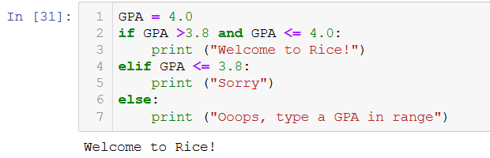
CONTROL FLOW – IF/ELSE
Exercise 5: Create a variable called "behavior", assign a value "good" to it
# if "good" print "candy"
# elif "bad" print "no candy"
# else print "ask your mom"

Slide 19
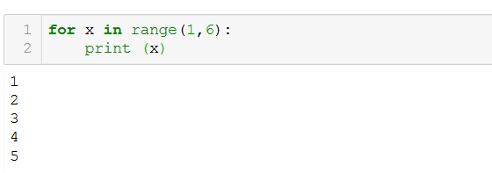
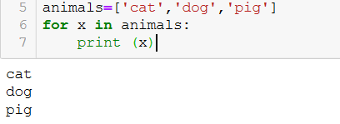
CONTROL FLOW – FOR LOOP
Exercise 6
Create a list called “animals" and put "cat","dog","pig"...in it
Use for loop to print each one out

Slide 20
Useful Libraries
Beautiful Soup – web scraping
NumPy – advance math functionalities
Matplotlib – graphs
Pandas – data structures and data analysis tools

